Slide 1

CODEMETRIC TECHNOLOGY
TESTING OF THE BURGER QUEEN APPLICATION
ALLEN, SCOTT NICHOLAS
180923 / 620099245
CLARKE, KHADEJA RENEE
180908 / 620098443
FRANCIS, NIGEL FITZGERALD
180925 / 415001546
NEILL, MISCHKA ZOILA
180913 / 620100135

Slide 2
AGENDA
INTRODUCTION OF TEAM MEMBERS AND THEIR CONTRIBUTIONS TO THE PROJECT
OVERVIEW OF TESTING PROCESS
BREAKDOWN OF TESTING PROCESS
QUESTIONS AND COMMENTARY

Slide 3
INTRODUCTION OF TEAM MEMBERS AND THEIR CONTRIBUTIONS TO THE PROJECT

Slide 4
OVERVIEW OF TESTING PROCESS

Slide 5

OVERVIEW OF TESTING PROCESS
MANUAL TESTING
AUTOMATED TESTING
ACCEPTANCE TESTING FRAMEWORK: CUCUMBER
TESTING FRAMEWORK: ESPRESSO
DATABASE TESTING

Slide 6
BREAKDOWN OF TESTING PROCESS

Slide 7
MANUAL TESTING

Slide 8
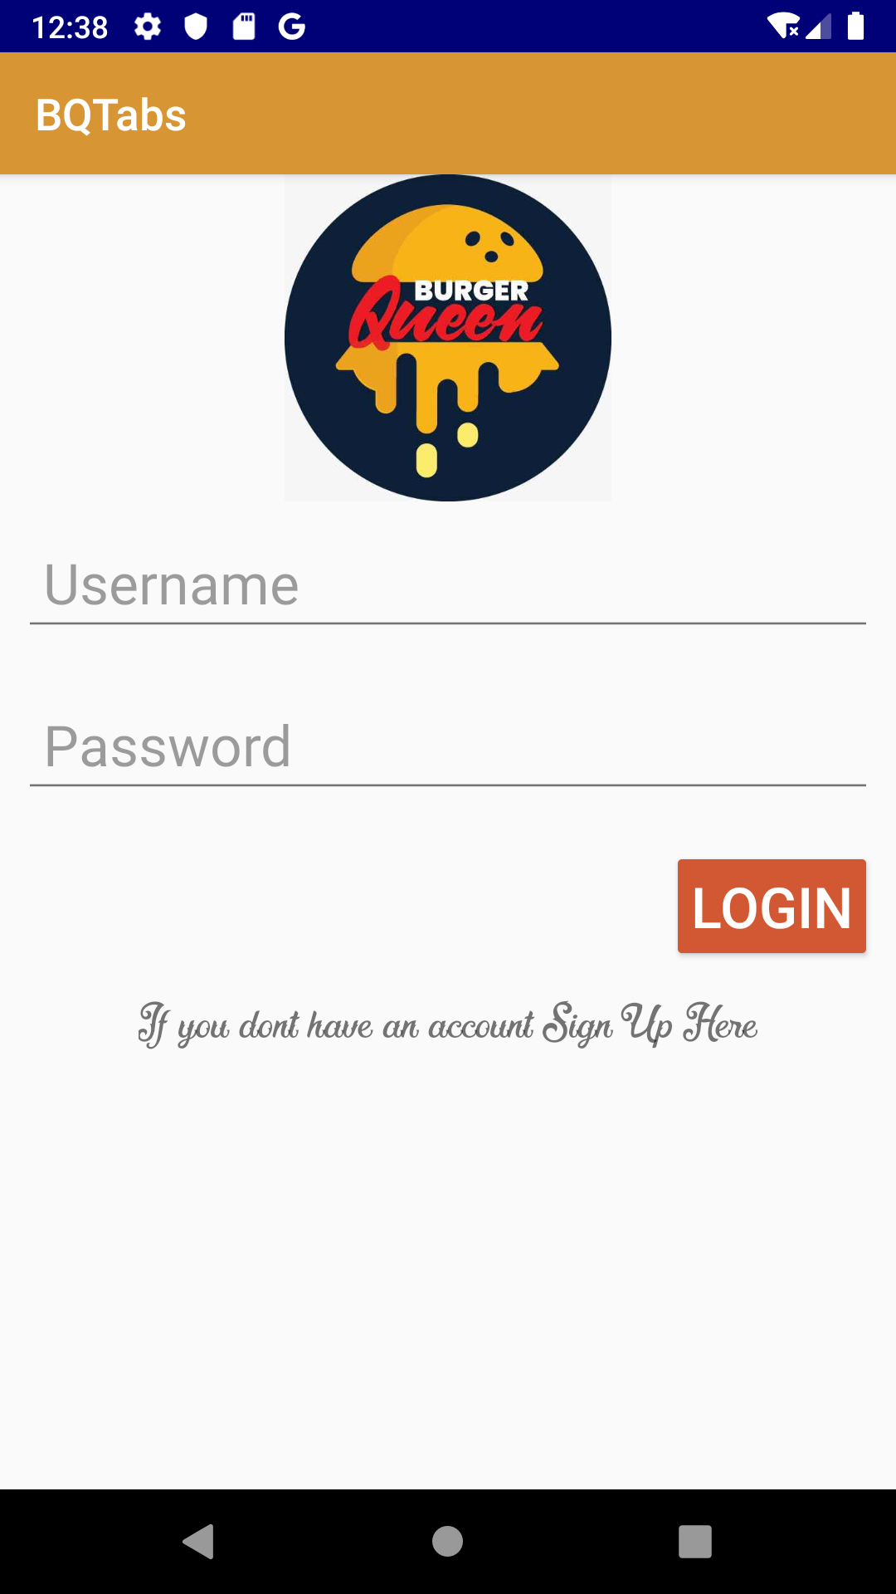
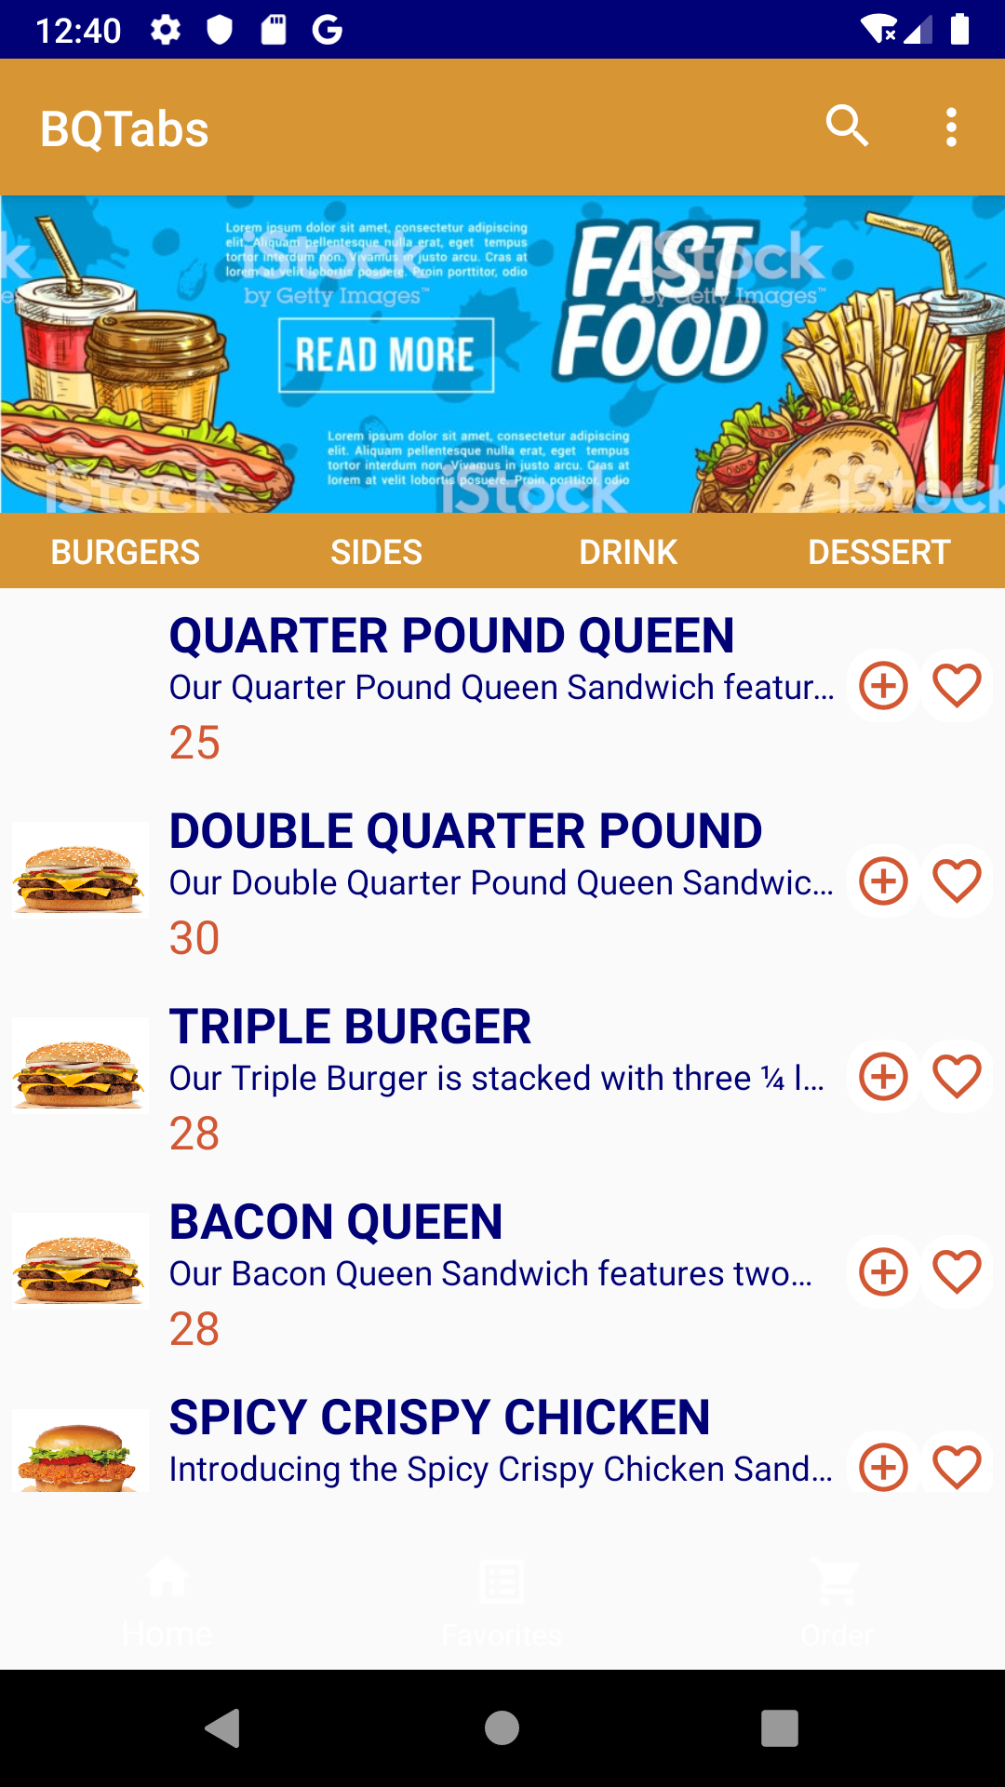
MANUAL TESTING
Font not very readable
Bottom Navigation Bar not visible

Slide 9
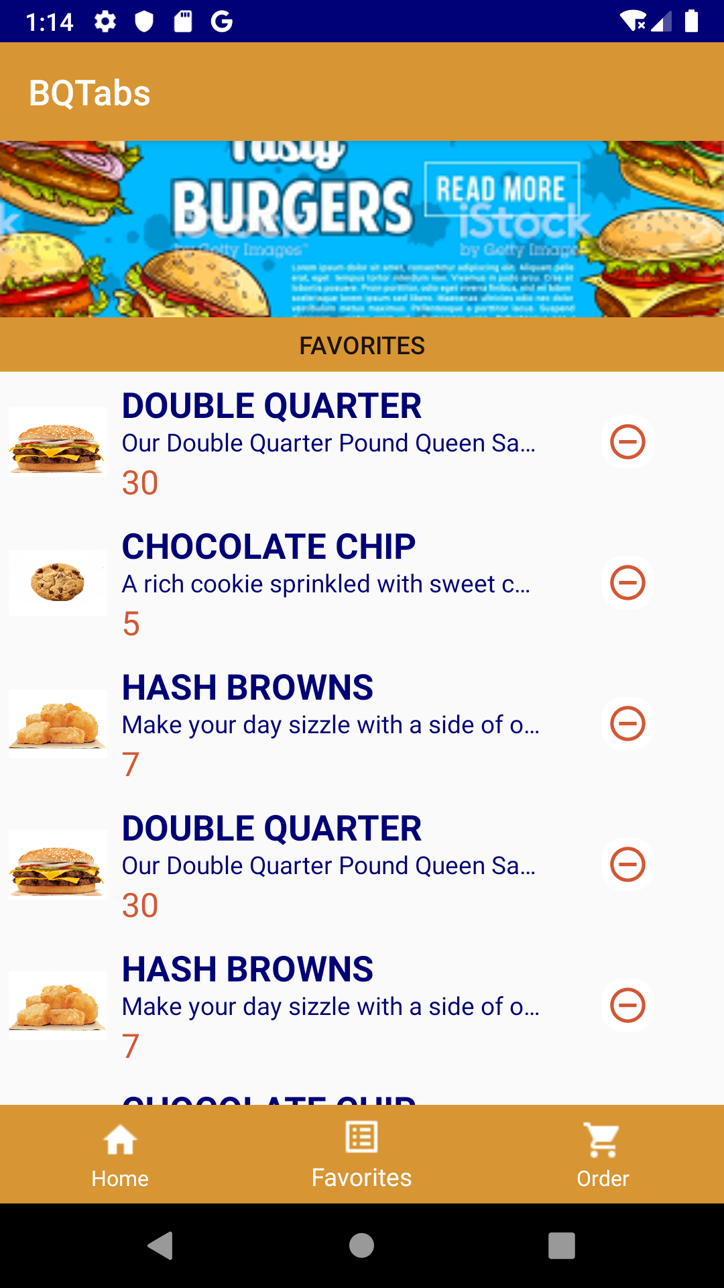
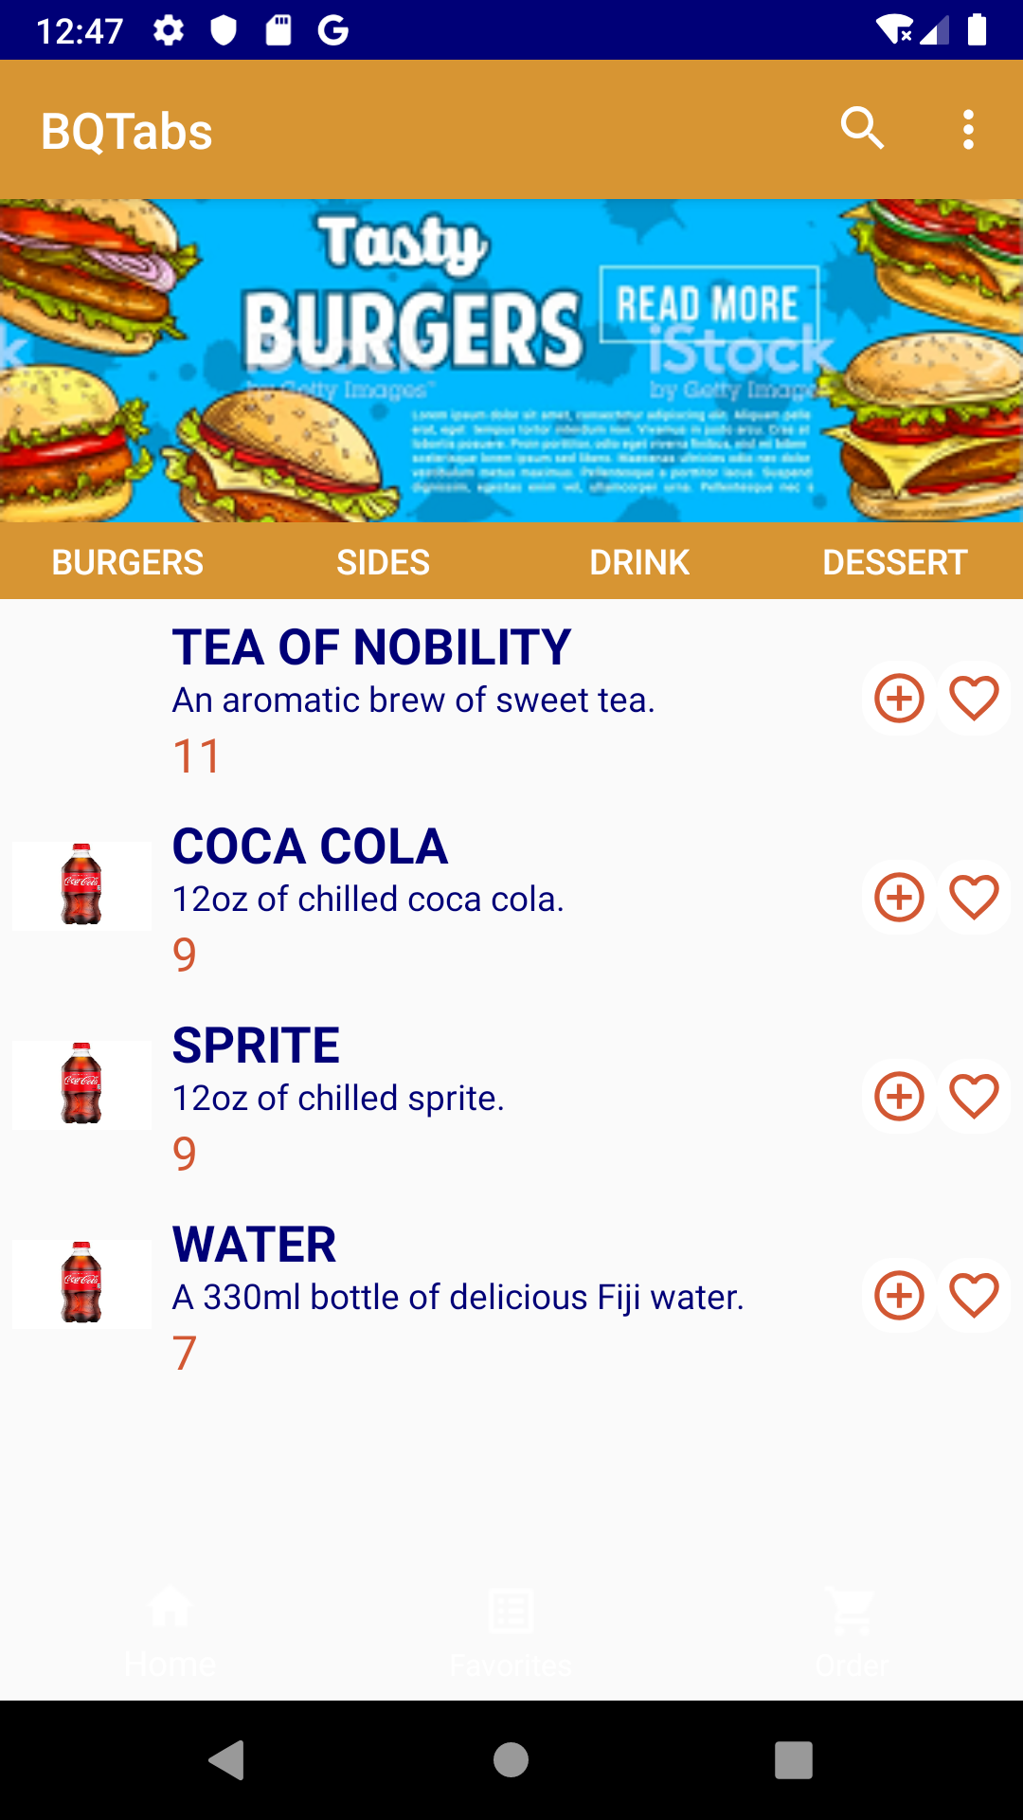
MANUAL TESTING
Duplicate items can appear in favourites
Not all images are accurate; Some are even blank

Slide 10
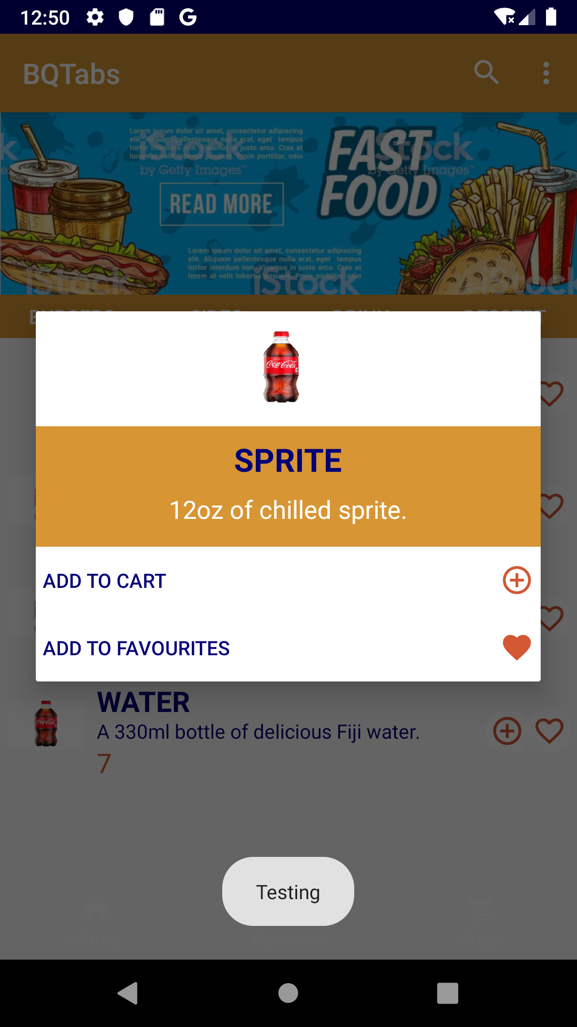
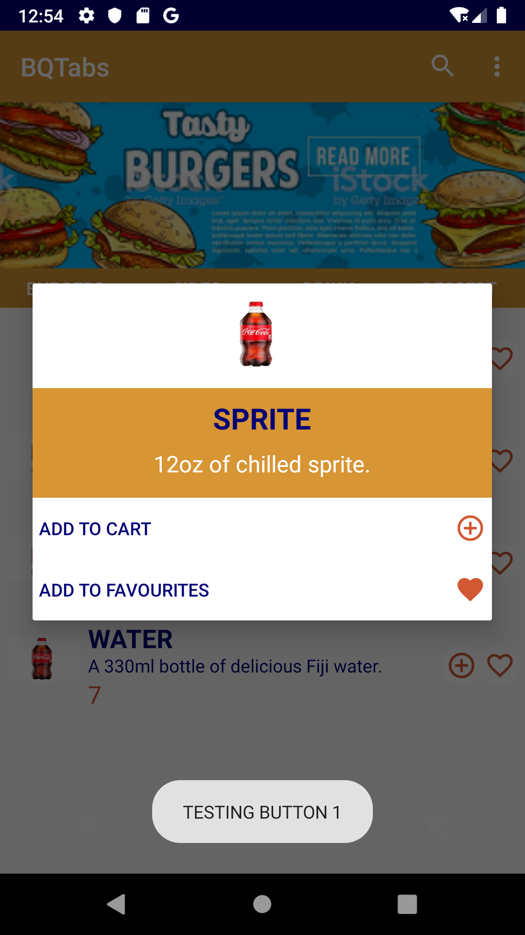
MANUAL TESTING
The message the Toast displays isn’t appropriate

Slide 11
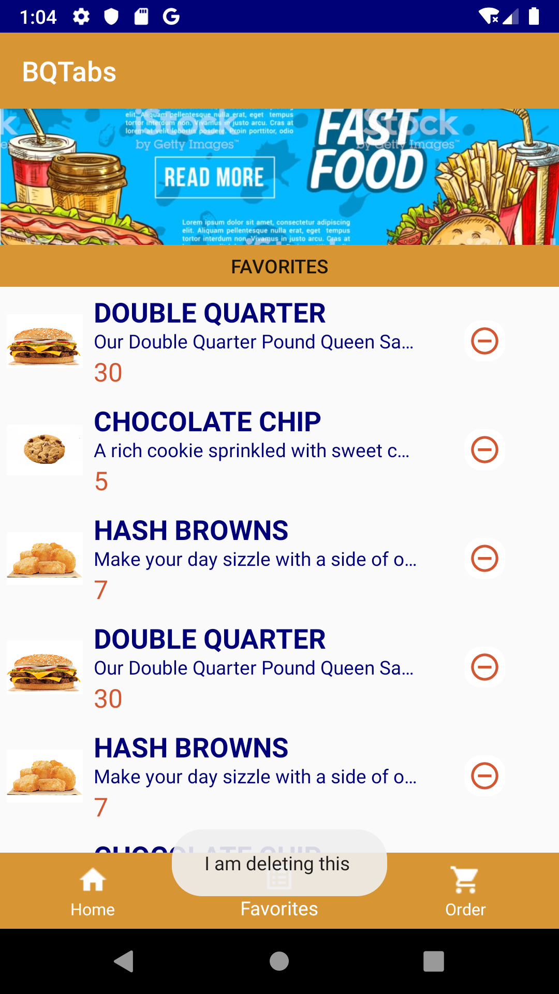
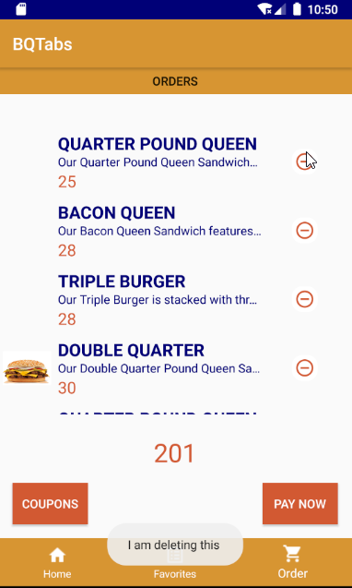
MANUAL TESTING
Though the Toast says the item is being deleted, it actually doesn’t delete

Slide 12
VALIDATION OF TESTING FRAMEWORKS used for automated testing
CUCUMBER:
Is simple enough for non-technical persons because it uses Gherkin
Supports several languages
Is not dependent on any specific testing framework
ESPRESSO:
Native Android testing framework
Faster execution time than other testing frameworks (Examples: Calabash, Appium)
Allows for easy navigation between tests and source code

Slide 13
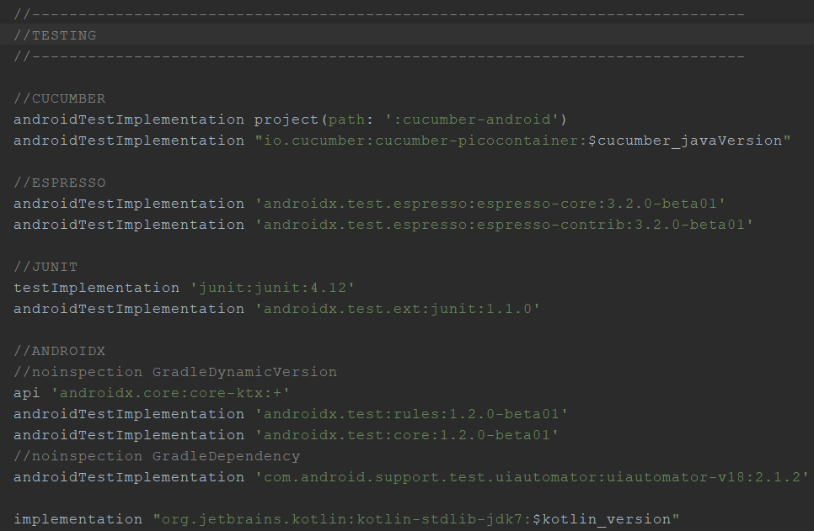
TESTING SUITE

Slide 14
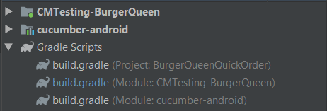
PROJECT MODULES

Slide 15
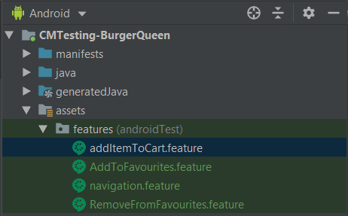
FEATURE FILES

Slide 16
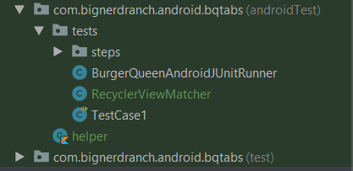
TEST CASES

Slide 17
Automated testing

Slide 18
Automated testing (cont’d)
AUTHENTICATION

Slide 19
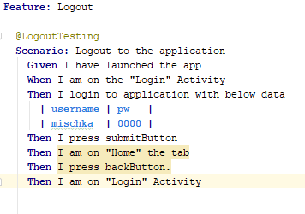
LOGOUT
FEATURE FILE

Slide 20
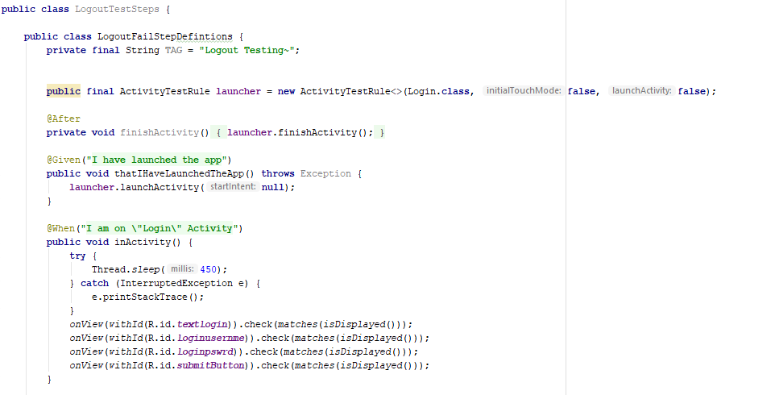
LOGOUT
STEP DEFINITIONS

Slide 21
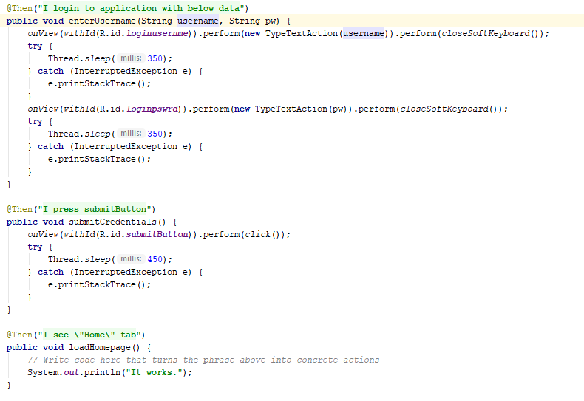
LOGOUT
STEP DEFINITIONS (CONT’D)

Slide 22
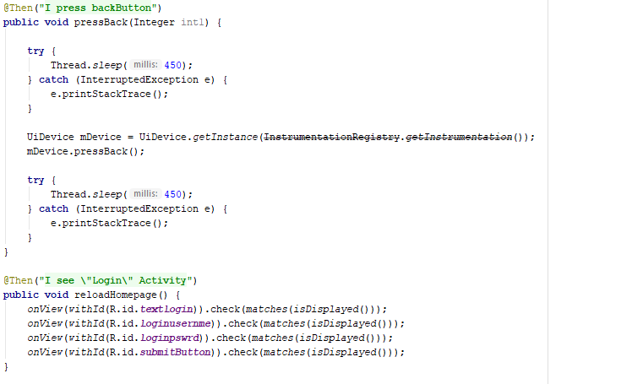
LOGOUT
STEP DEFINITIONS (CONT’D)

Slide 23
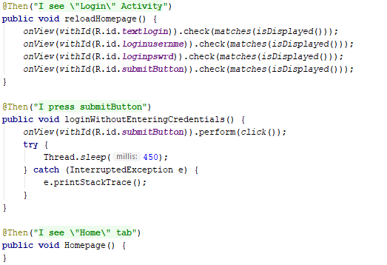
LOGOUT
STEP DEFINITIONS (CONT’D)

Slide 24
Automated testing (cont’d)
favourites

Slide 25
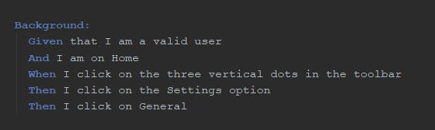
ADD TO FAVOURITES
BACKGROUND

Slide 26
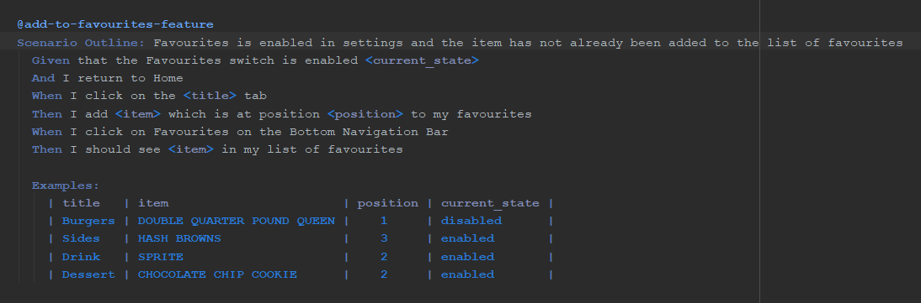
ADD TO FAVOURITES
FAVOURITES IS ENABLED AND ITEM HAS NOT YET BEEN ADDED TO FAVOURITES

Slide 27
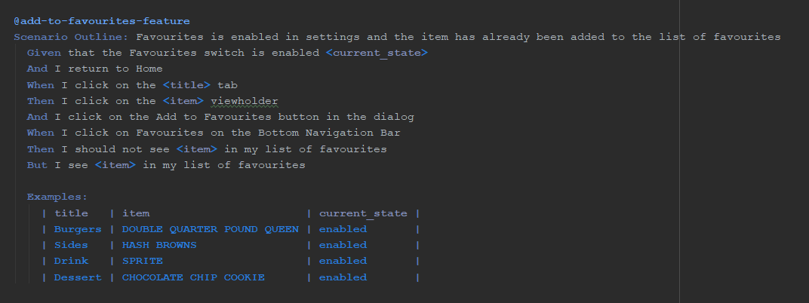
ADD TO FAVOURITES
FAVOURITES IS ENABLED AND ITEM HAS ALREADY BEEN ADDED TO FAVOURITES

Slide 28
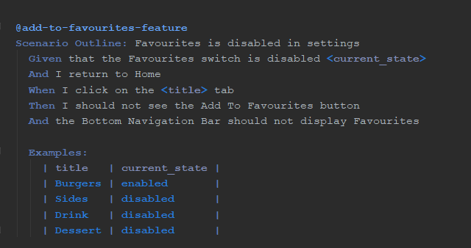
ADD TO FAVOURITES
FAVOURITES IS DISABLED

Slide 29
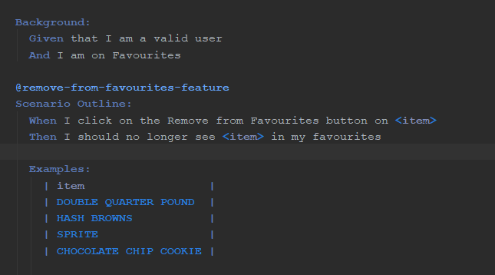
REMOVE FROM FAVOURITES
ITEMS HAVE BEEN FAVOURITED

Slide 30
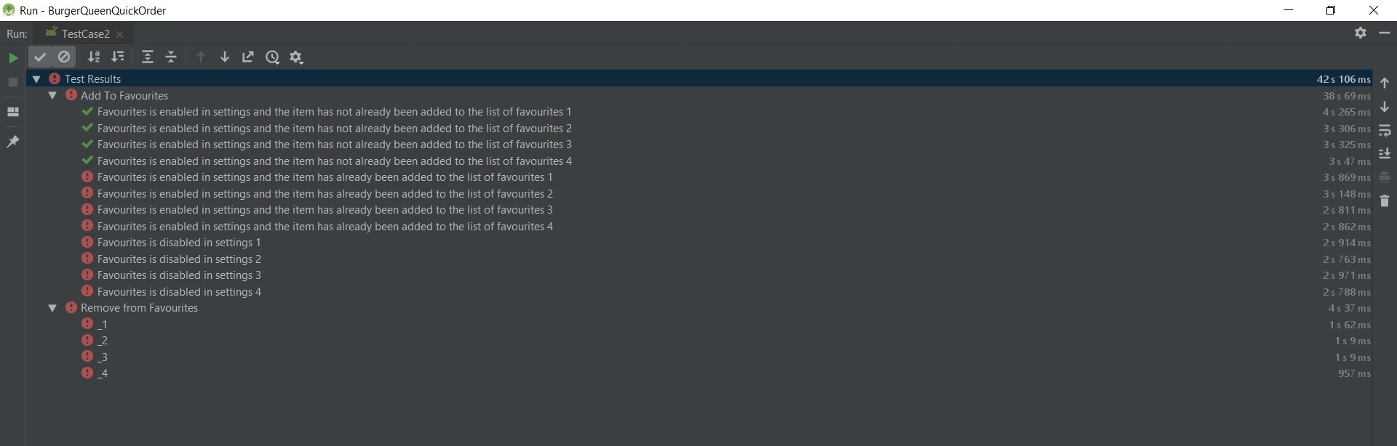
FAVOURITES
RESULTS FROM AUTOMATED TESTING

Slide 31
Automated testing (cont’d)
CART

Slide 32
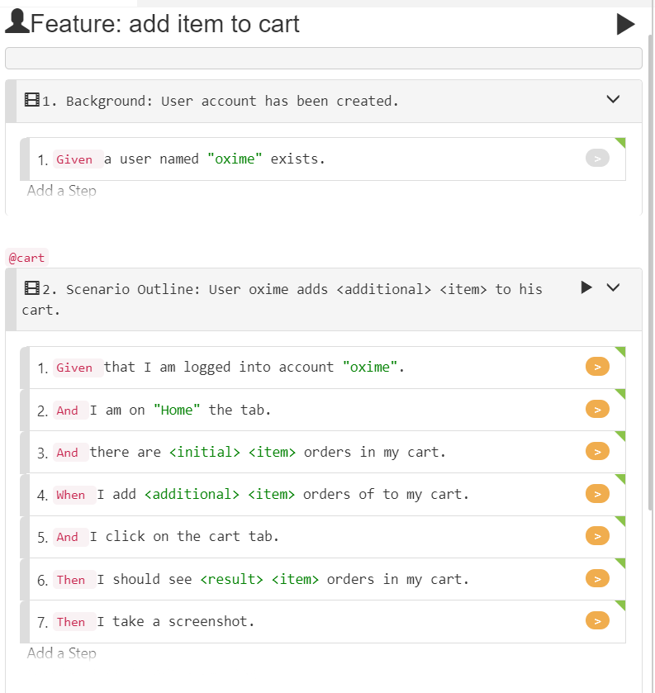
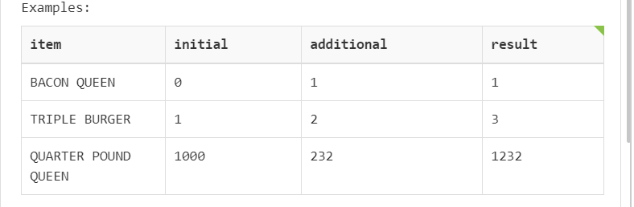
CART

Slide 33
DATABASE testing

Slide 34
PROBLEMS
SECURITY
Dummy user created on program start. This is a backdoor in very simple terms.
User Password is not encrypted.
Username and password do not have strong complexity
Password doesn’t force the user to use special characters and alternate cases
“Log.i” used throughout the code
Example: Log.i("UserName: ", user_session_obj.getUsername());

Slide 35
PROBLEMS
DATABASE
Duplicate username, duplicate email
Null values can be saved in the database
Database structure is bad as users are only linked to coupons. Favorites and order list are in no way linked to user id
SQL injection can be done in register and update user
Update user info has an issue

Slide 36
SOLUTIONS
SECURITY
Remove the line of code adding the dummy user
Encrypt the password
Remove all Logcat

Slide 37
SOLUTIONS
DATABASE
Check the database against the username and email before insertion.
Check the edit text for empty string and null value before inserting into database recheck again and after inserting into the database check it again in the database. Also when retrieving perform the check again.
Create an extra column in favorites and order list to link the user id
To prevent SQL injection create prepared statements and using the place holder ? SQLite wi
By using the placeholder ? SQLite automatically treats the data as input data and it does not interfere with parsing the actual SQL statement.
Use a regular expression for user name and password. That way you can limit the type of special characters accepted.

Slide 38
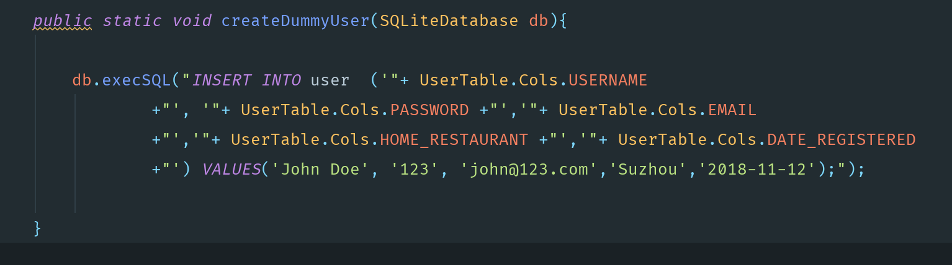
DUMMY USER

Slide 39
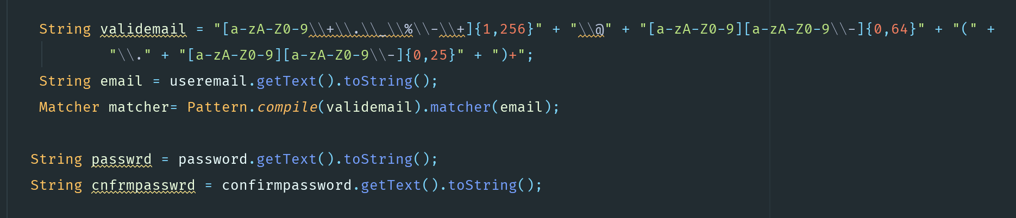
EMAIL REGEX

Slide 40
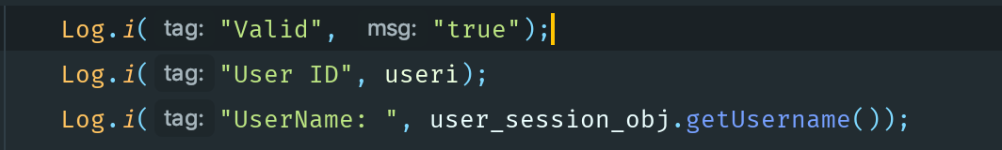
LOGCAT

Slide 41
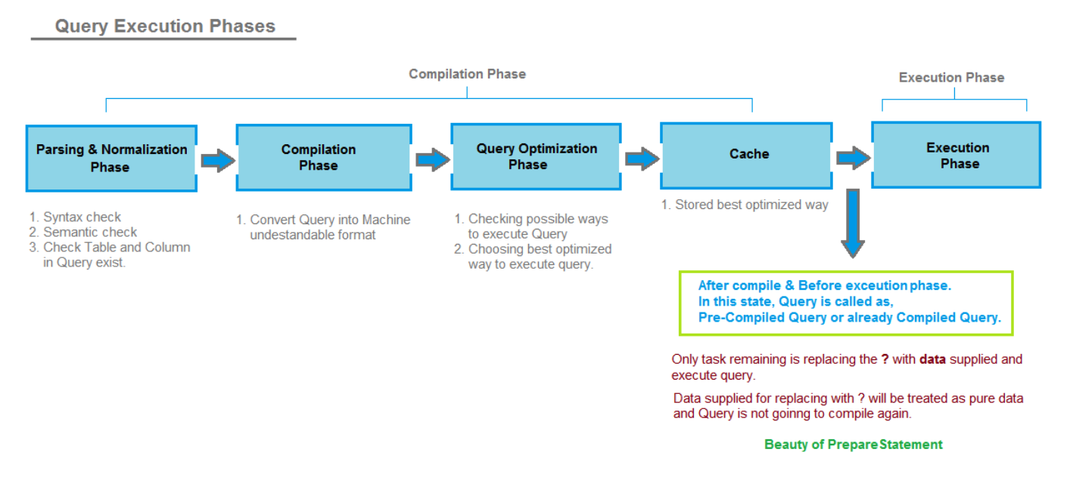
PREPARED STATEMENTS

Slide 42
PLACEHOLDER

Slide 43
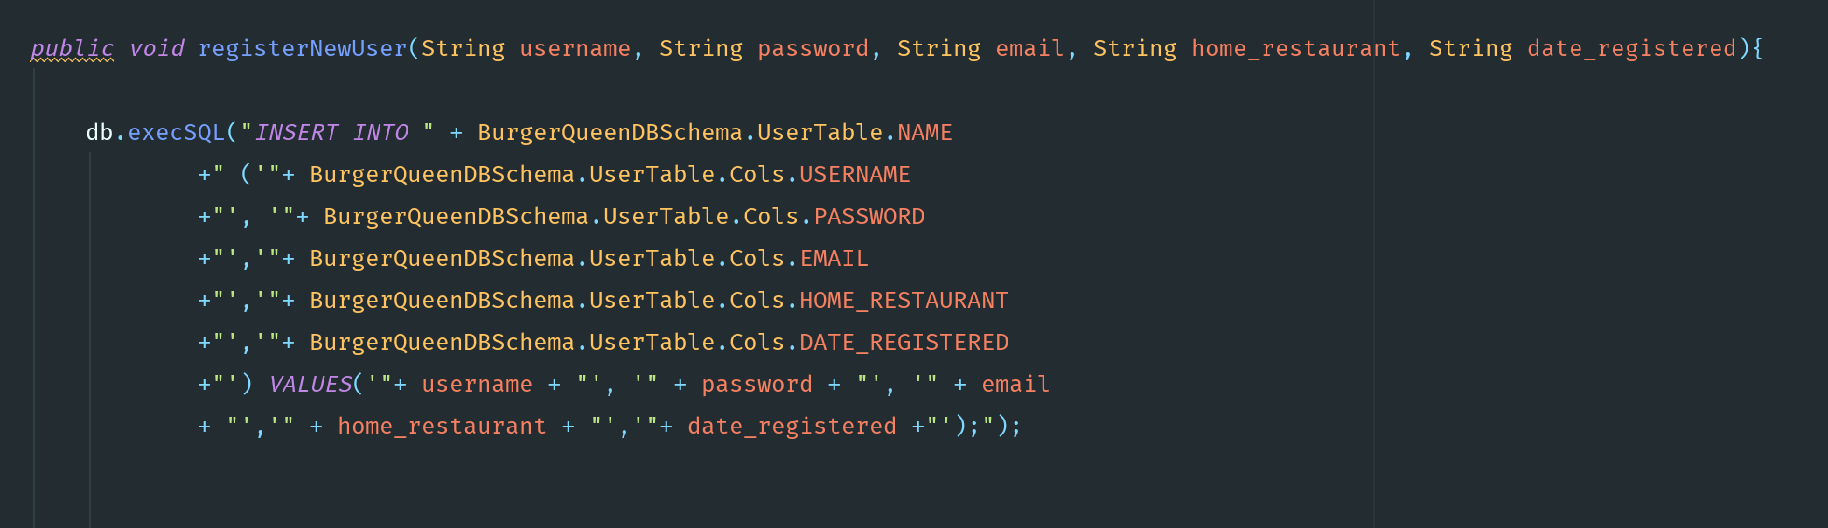
REGISTER USER

Slide 44
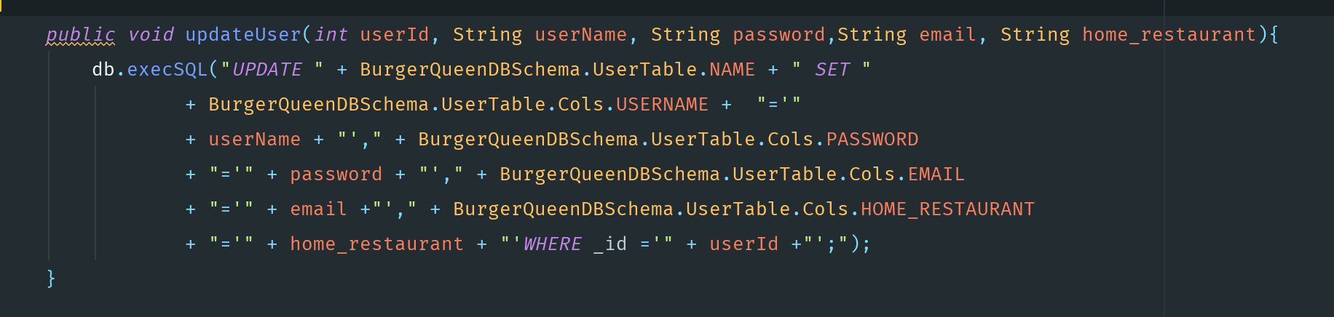
update USER

Slide 45
QUESTIONS and COMMENTS

